Slide 1
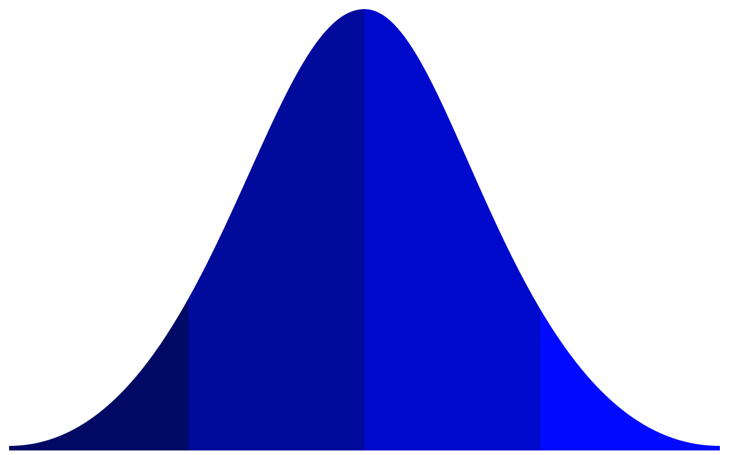
ANALYSIS OF GOOGLE PLAY STORE APPLICATIONS
PROF. Mohammad Dehghani
GROUP 12:
ANISH NAIR
BHAVYA BATRA
JANVI JANI

Slide 2

Scope and objective
The aim of the project is to collate and compare different attributes of applications on google play store in-order to derive meaningful insights.
We have created a number of tables, graphs and plots throughout the course of our project as it helps a developer to understand the trends, patterns and customer demands better and thus them to popularize their product.
Through our exhaustive analysis, a developer can gain actionable insights and capture the Android market. It helps one to gain insights about their competitors- what are their strategy, strengths, and weaknesses.
It gives developers an edge over their competitors.

Slide 3
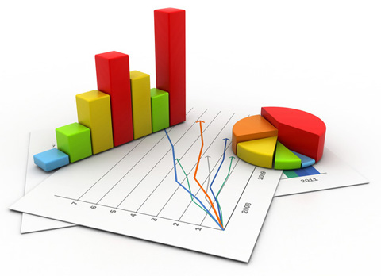
Data Description
The dataset contains a total of 7800 data entries and 11 attributes. These 11 variables are listed as follows:
App: Names of the apps present in the Google play store
Category: Represents the Category of all the applications
Rating: Represents the ratings given to all the apps on a scale of 1-5
Reviews: Represents the number of reviews given to the apps
Size: Size of all the apps in MB
Installs: Represents the total number of installs of each app
Type: Type of app (Free or paid)
Price: Represents the price of each app in USD
Content: Age group the app is targeted at
Genres: Same as category
Log_Installs: Log of Installs for the ease of calculation

Slide 4

Data pre-processing
The raw dataset contained 10,000 observations with 13 variables initially. The following preprocessing steps were taken to bring the data in a representable form:
Removing all the rows containing NA and missing values
Deleted unnecessary columns like Last. Updated, Current. Ver and Android Ver
To ease our calculations, we calculated the log of the Installs variable
After filtering the data, we had a main dataset with 7724 observations and 11 attributes

Slide 5
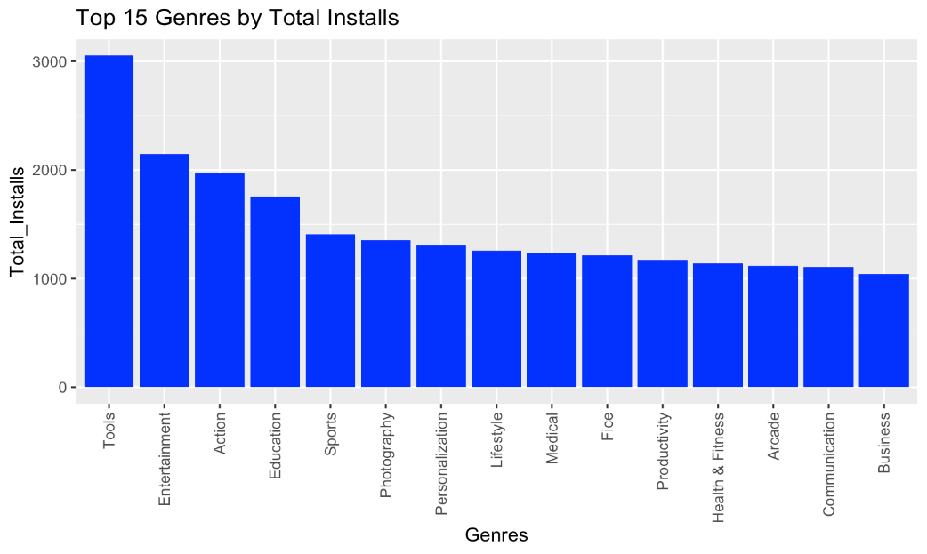
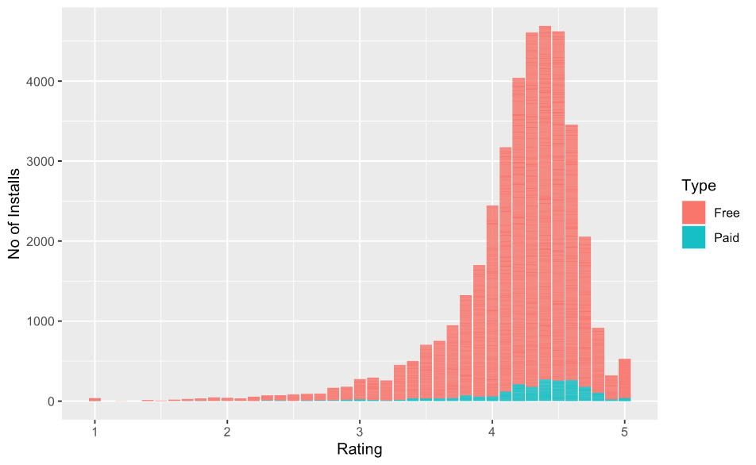
EDA-Data visualization
We created a Bar Plot to find the Top 15 Genres of apps that are most popular among users. The popularity is considered in terms of the number of installs users have made.
The plot on the right is a Histogram for the Installs and Rating differentiated by Type that shows how the number of installs of free or paid apps changes as the rating changes. The histogram is Highly negatively skewed with skewness equal to -1.75.

Slide 6
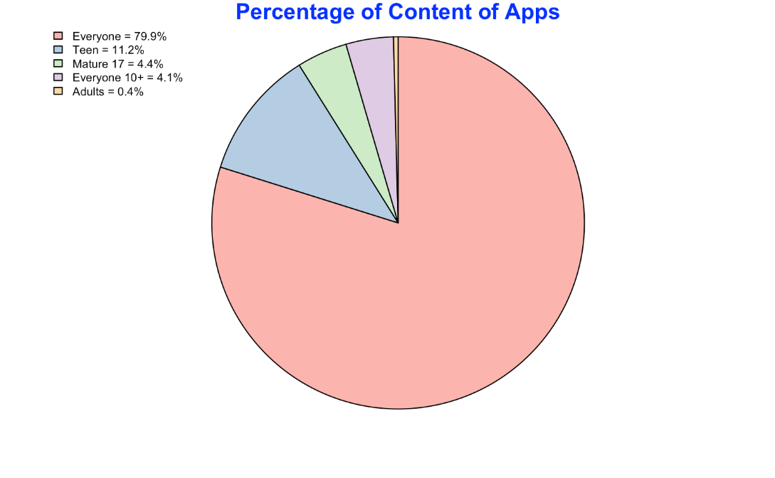
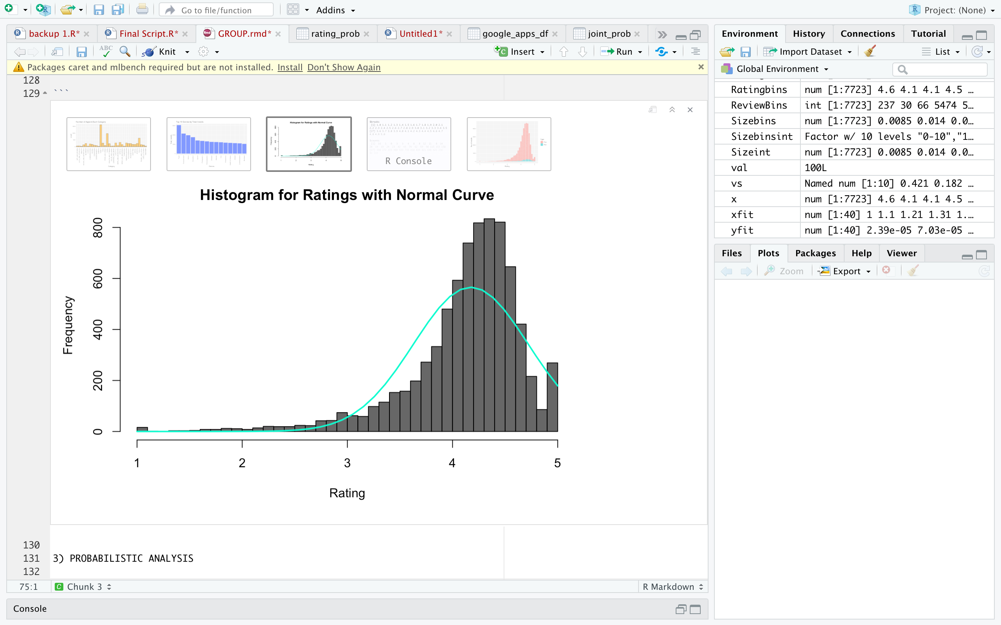
EDA- Data visualization
Percentage of content of apps
We made a Pie chart to represent the percentage of the content type.
The chart below shows that 79.9% of apps in the play store are meant for all age groups whereas 0.4% of apps are meant for adults.
Our objective was to showcase the distribution of the application ratings.
From the plot below, you can see that the variable is left-skewed.

Slide 7
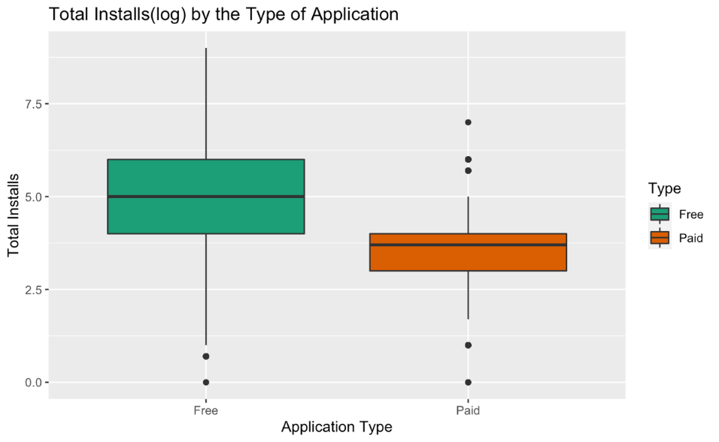
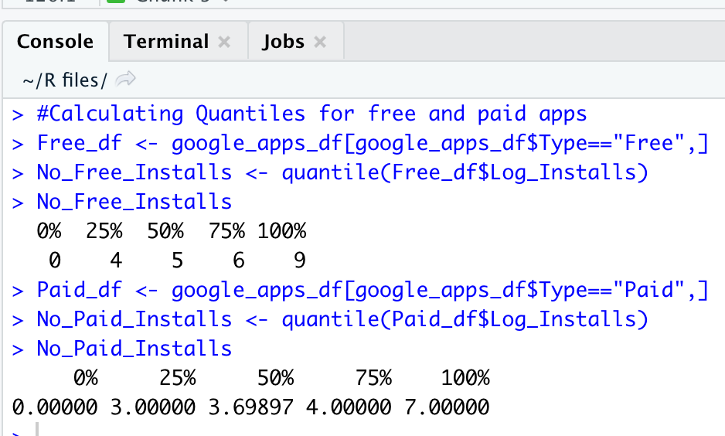
EDA- Data visualization
This is a Boxplot that represents the Total Installs(log) by the Type of Application. The purpose was to check which type of app is installed more by the people. The plot shows that the quantiles of free apps are more than paid apps.
Therefore, we can conclude that people install free apps more than paid apps.

Slide 8
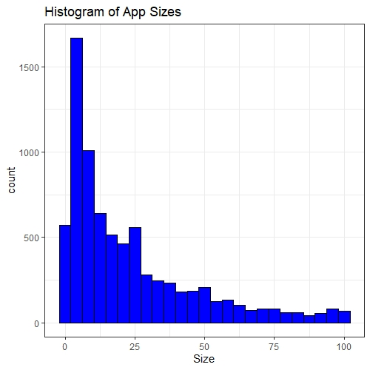
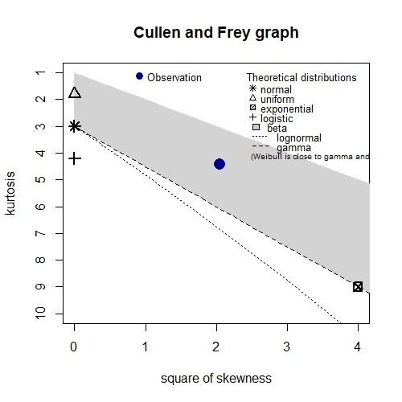
Goodness of fit
The graph showcases the distribution of the continuous variable Size.
The graph is right skewed. Using Fitting Distributions, the AIC values obtained for normal distribution and lognormal distribution were 70649.81 and 64755.69 respectively.
As the AIC value for lognormal distribution is less than the AIC value for normal distribution, it is a more fitting distribution.
This is also indicated by the Cullen and Frey Graph:

Slide 9
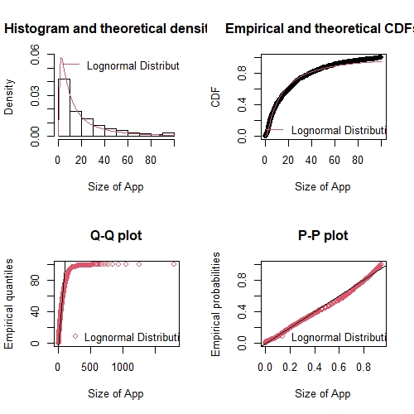
Goodness of fit
The QQ-plots and PP-Plots for the lognormal distribution. We can see that the lognormal line lies in line with the graph values.
Therefore, from the evidence shown, we can state that the Size of the App values follow a lognormal distribution.

Slide 10
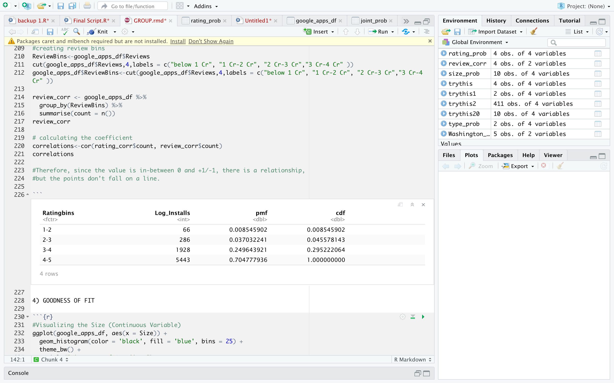
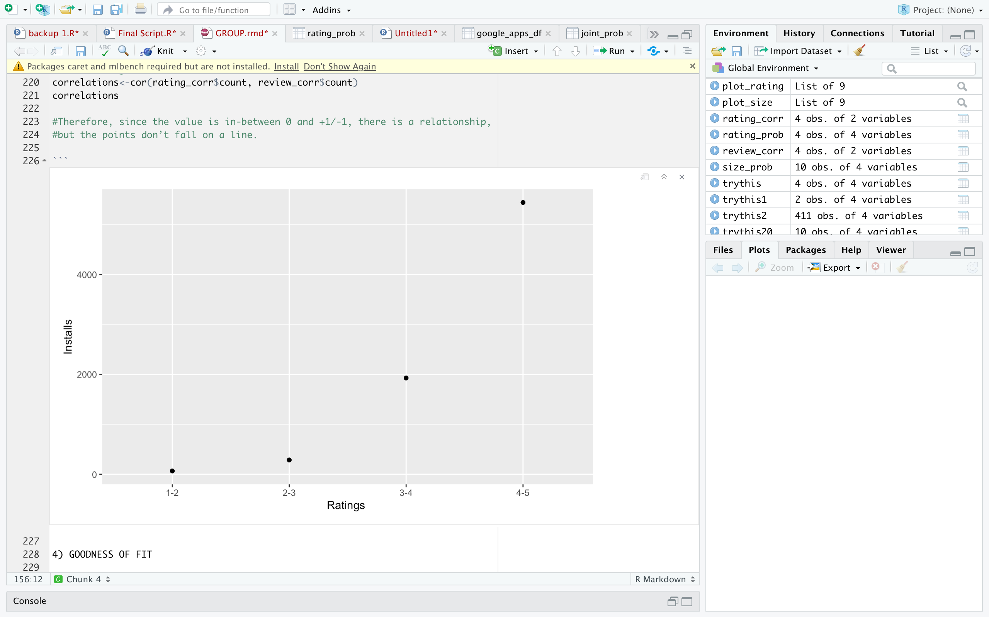
Statistical analysis: probabilistic analysis
Find out the count of installed applications according to ratings given to each application and put them in rating bins.
Find out the CMF and PDF of each rating bin.
The weighted mean of app ratings comes up to 4.188995
We can conclude that the higher the rating of the app, the greater is the number of installs.
PMF and CMF of ratings v/s the no of installs

Slide 11
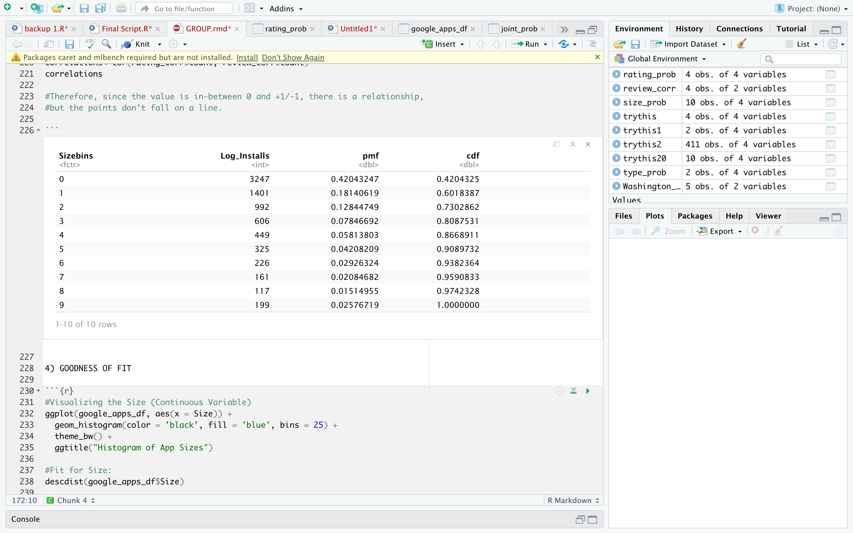
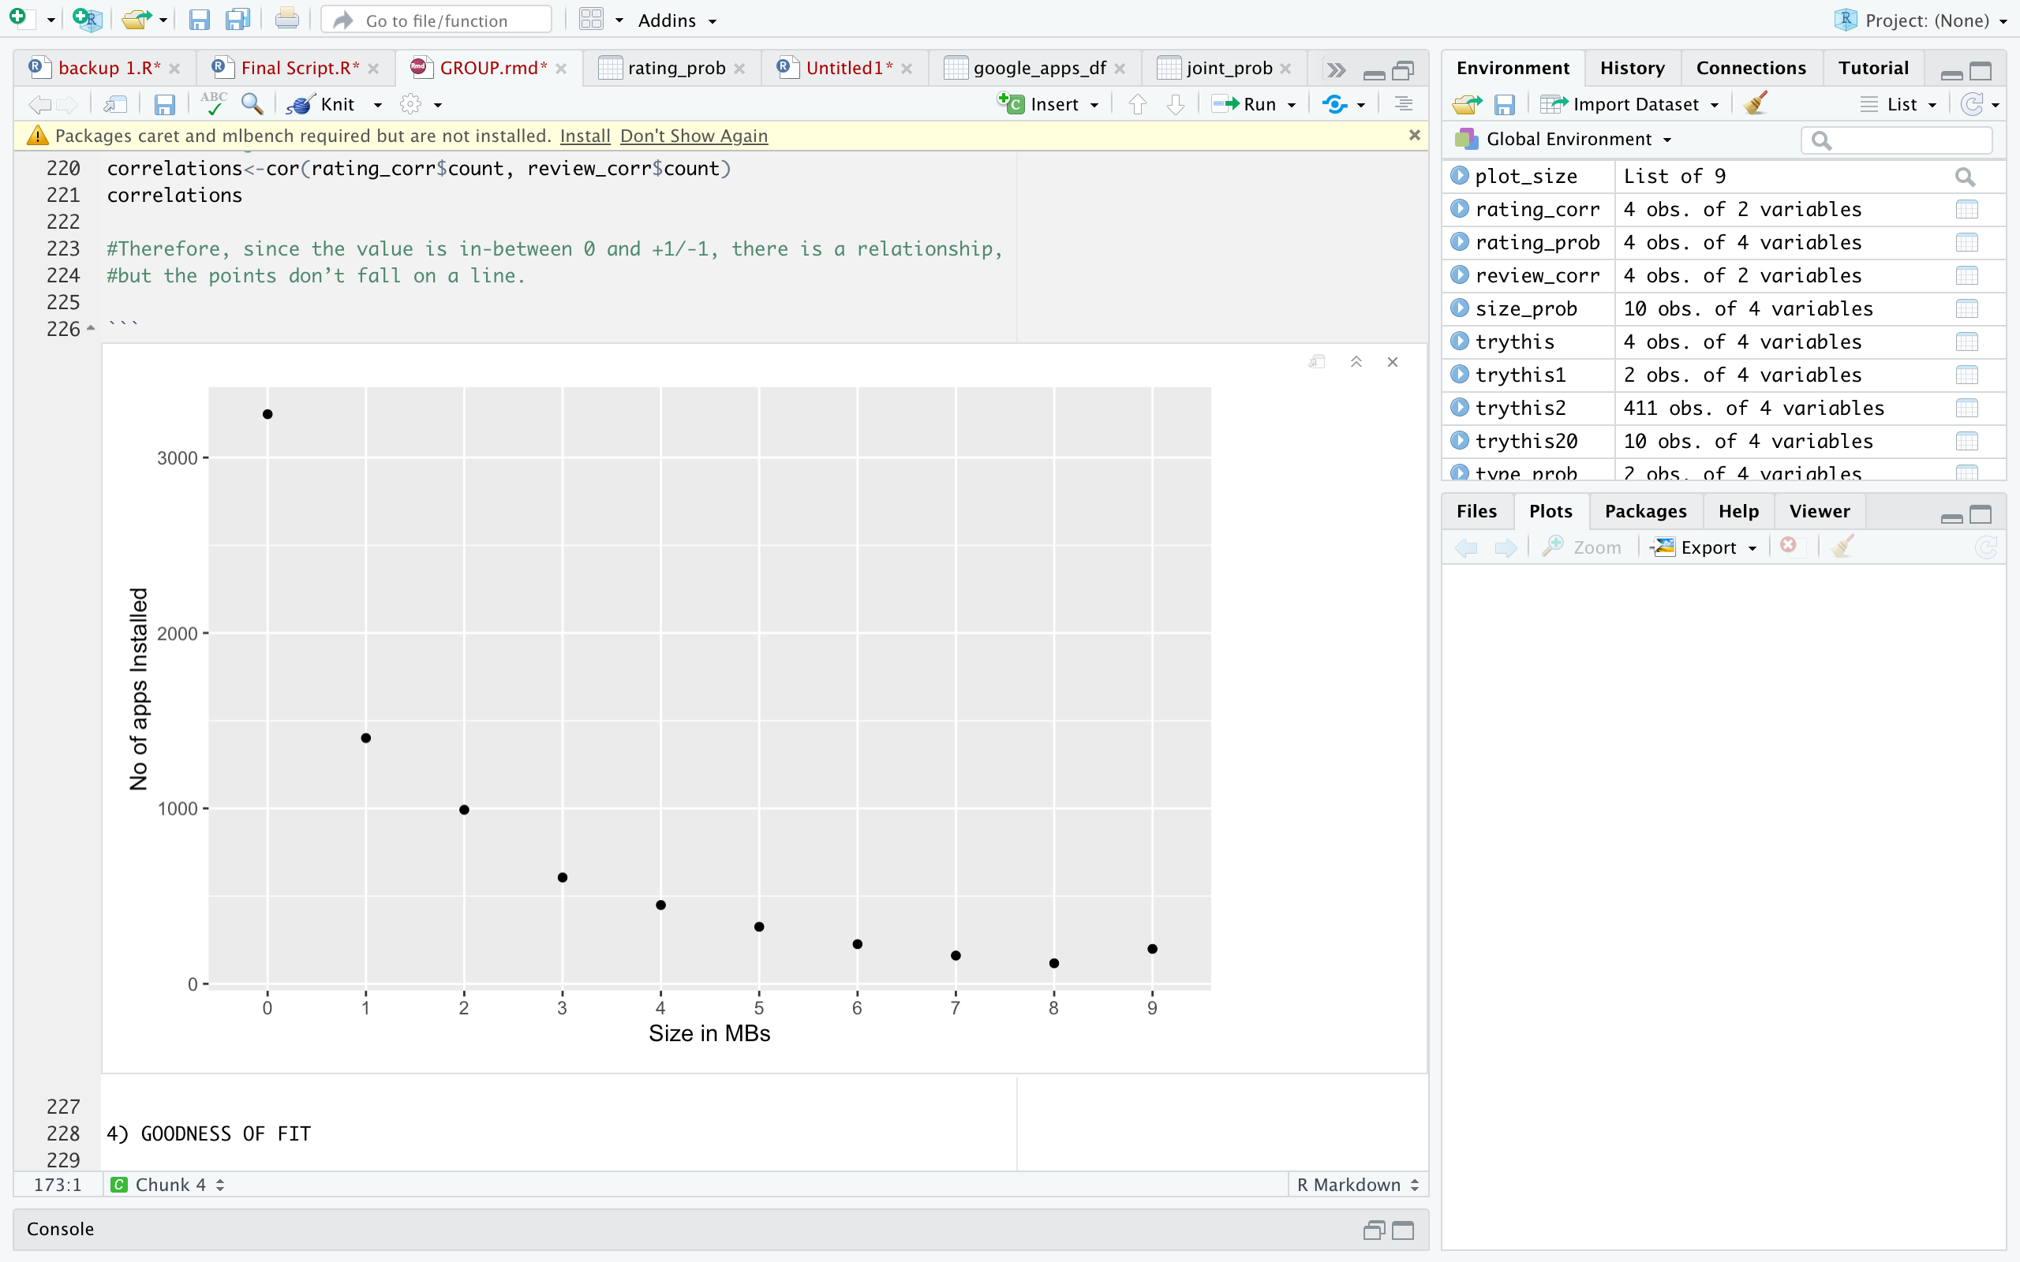
probabilistic analysis continue….
We have created the following types of bins for size of application: <0 mb, 1mb to 2mb, 2mb to 3mb, ……… ,90-100mb, >10mb.
Then we create a new data frame to find the CMF and PDF of applications installed based on size of applications.
We can conclude that, as the number of installs of an application decreases as the size of the application increases.
PMF and CMF of size v/s the no of installs

Slide 12

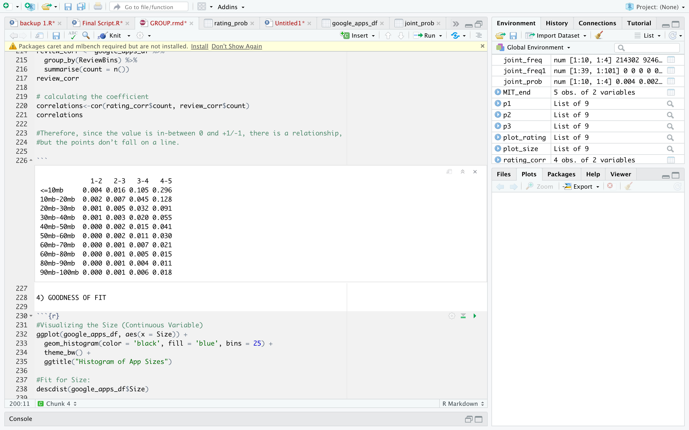

probabilistic analysis continue….
Joint Probability of Apps installed
Hence, we can conclude that the probability of an application being installed is more if it has a size range <=20 mb and has a rating between 4.0 and 5.0.
This Photo by Unknown Author is licensed under CC BY-SA-NC

Slide 13

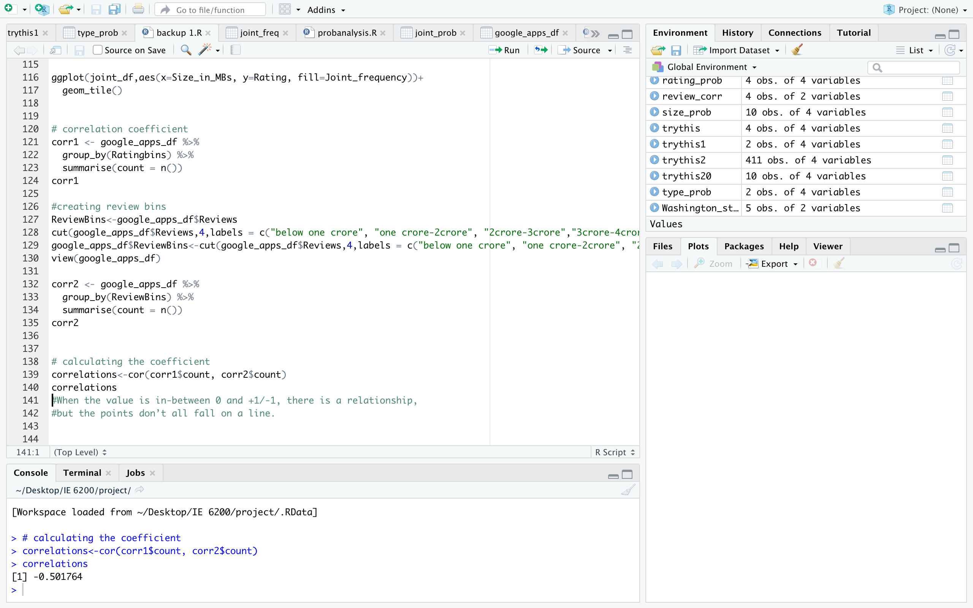
probabilistic analysis continue….
Correlation Coefficient:
We would like to know if an app given a higher rating also has more comments or vise versa.
Our correlation coefficient comes up to -0.501764.
From this, we can conclude that since the value of correlation coefficient is in-between 0 and -1 the points are scattered.
There exists no relationship between the number of reviews that an app receives and the rating that the app receives.

Slide 14
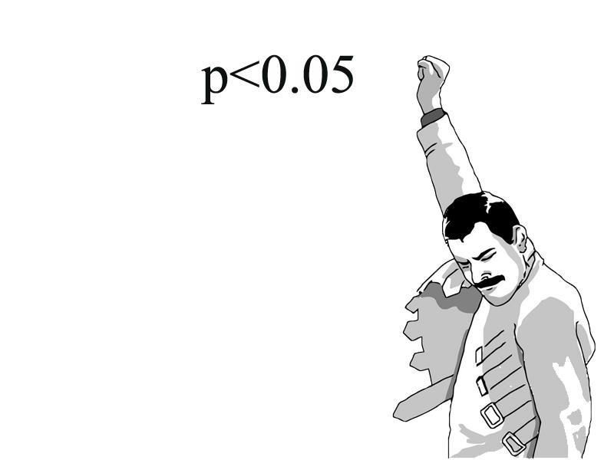
Hypothesis testing – Testing 1
Checking whether there is a significant difference between the mean rating of free and paid apps.
We have used a two-tailed t-test with a confidence interval of 95% to test the above hypothesis. The null and alternative hypothesis are defined below:
H₀ - True mean rating between paid and free apps are the same
H₁ - True mean rating between paid and free apps aren't the same
On performing the two-tailed t-test, we get a p-value of 0.0004144, which is less than the α value of 0.05.
Therefore, we can reject the null hypothesis and state that there is a significant difference
between the mean rating of free and paid apps.

Slide 15
Hypothesis testing – Testing II
Whether there is a significant difference between the mean of Rating from a random sample of 1000 apps and the mean of Rating for the entire population’
For the above hypothesis problem, we have used a one sample z-test with a confidence interval of 95%. Assuming the entire dataset as the population, we want to test whether the mean rating of the sample we are taking is equivalent to the mean rating of the population. The null and alternative hypothesis are defined as:
H₀ – Mean of sample Rating is equal to 4.155
H₁ - Mean of sample Rating is not equal to 4.155
On performing the one sample z-test, we get a z-value of 0.8863162. The z-value lies within the range [−1.96,1.96]. Thus, we fail to reject the null hypothesis and conclude that there is no significant difference between sample mean Rating and population mean Rating

Slide 16
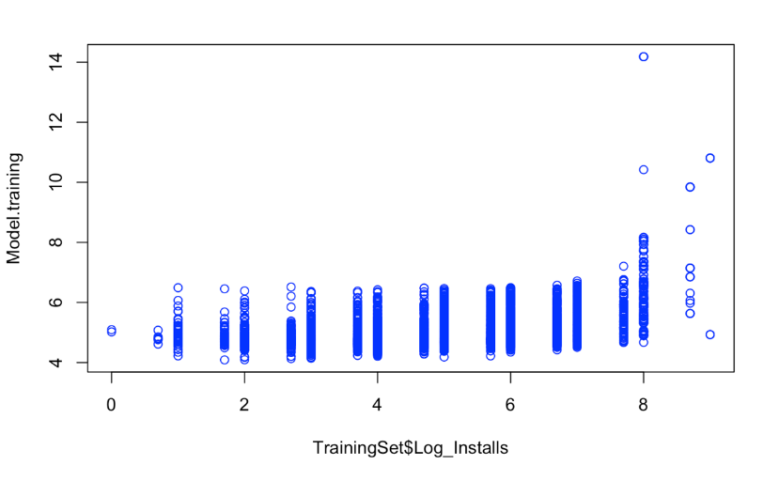
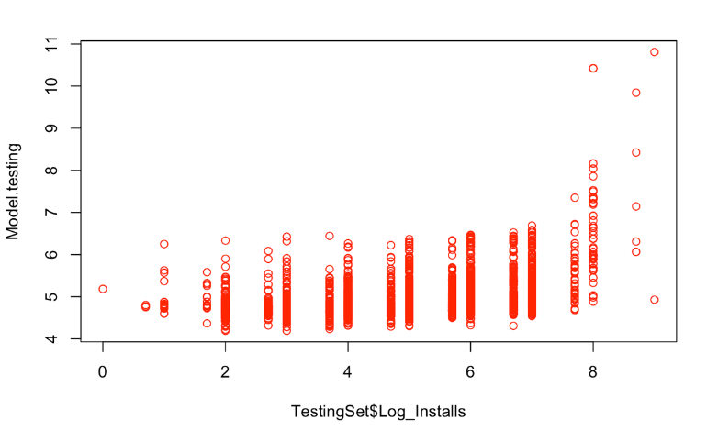
Advanced analytics : Multiple linear regression
We used Multiple Linear Regression Model to predict the number of installs of apps using three independent variables (Ratings, Size and Reviews).
Once the dataset is trained, the testing set is sent in the predict function for testing the trained model. The two plots represent the predicted value of the training and testing model.

Slide 17
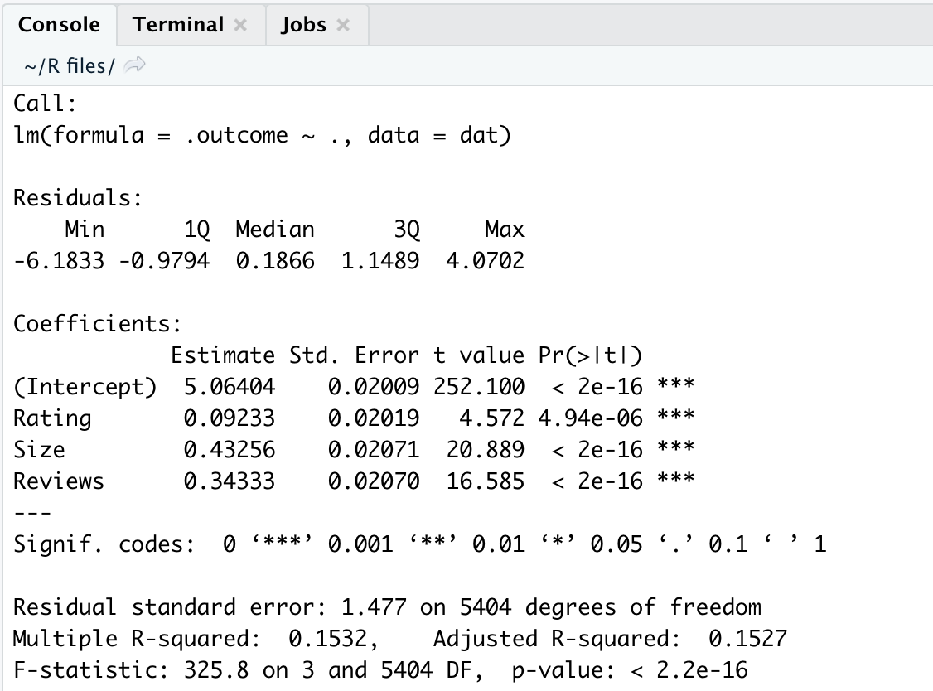
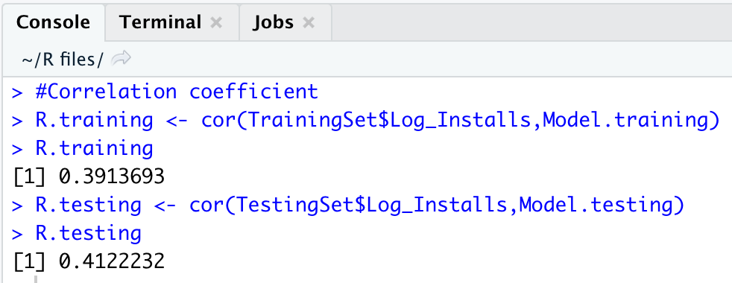
Multiple linear regression continue…
We calculated the correlation coefficient as 0.4 for the predicted value.
The output shows that the three variables used in the model to predict the number of installs is somewhat linearly related with the Installs attribute.
The above output shows the performance metrics where intercept refers to y intercept and it has a standard error of 0.020.
Below intercept is the regression coefficient of x variables.

Slide 18
Conclusion
Through this project, we have been able to apply all what we learnt in the labs on a real-world data set containing information of apps in the Play Store.
We were able to experience the steps involved in the approach to solve any real word problem.
From the Exploratory Data Analysis where you get an intuitive idea and feel about the data you are working with to the implementation of statistical analysis like hypothesis tests and advanced analytics like linear regression.

Slide 19
